Slide 1


Employee Assistance Program
Supervisor Orientation
SCORE

Slide 2

Modern EAP Solutions

Slide 3

New Workforce Solutions
Clinical support for any emotional issue
Training and HR support services
Critical incident response
Work-life referrals and resources
Legal and financial wellness
24/7 program access
Strategic program promotion
ACI provides exceptional customer experiences with safe, compliant and
quality support.
Notes:
Clinical Assessment
Work-Life Services
Personal Services
Trainings & HR Support Services: In-Person, Online, YouTube Videos, Management Training Series
Critical Incident Response
Dedicated Account Management Team

Slide 4

Eligibility
Each employee’s definition of family
is ACI’s definition of family.
EAP services are all-inclusive, with no barriers to access for family members, regardless of location or relationship.
Notes:
ACI includes all family members – Even out-of-state family!
No ID cards or eligibility feeds necessary to access
All have access to program:
Parents
Children
Grandparents
Spouses
Significant Others

Slide 5

EAP Clinical Support Services
ACI’s EAP can help with any issue affecting emotional well-being, including but not limited to:
Emotional wellness
Stress management
Family/relationship issues
Anxiety and depression
Coping with grief
Anger management
Substance abuse
EAP clinical sessions are intended for assessment, referral, and short-term problem resolution. ACI offers multiple avenues of support for employees:
Up to 3 face-to-face assessment and short-term problem resolution sessions per year
Online assessment
Online clinical sessions
100% follow-up
Notes:
Change session model and footnote according to client contract

Slide 6

Provider Network and Credentialing
40,000 providers nationwide
and 12,000 globally
Master’s degree minimum
Five years of EAP experience
License and liability insurance
Multiple call centers worldwide

Slide 7










Comprehensive Work-Life Services
Emotional
Well-being
Financial Wellness
Modern Family Support
Pet Care
Healthy Living
Management Tools
Legal Resources
Veteran Assistance
Elder Care
Education

Slide 8
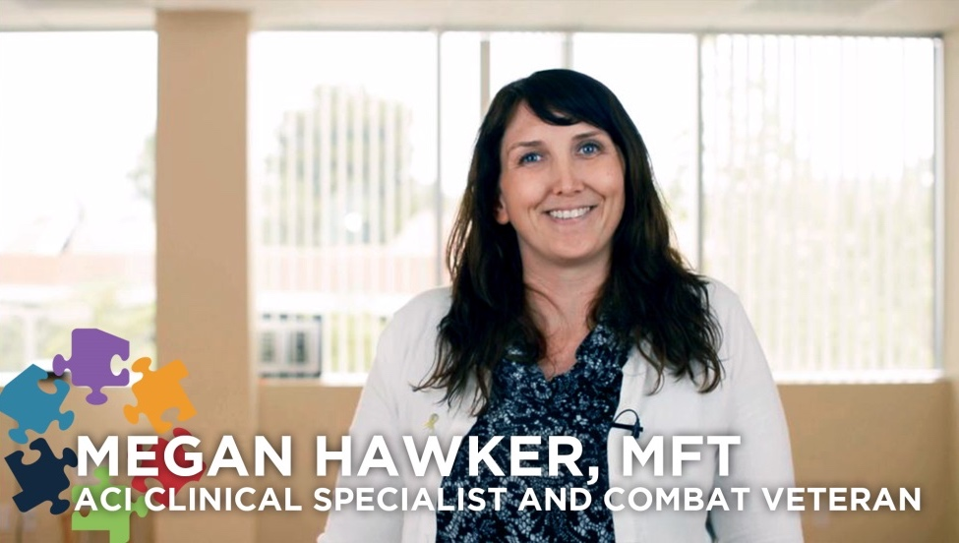

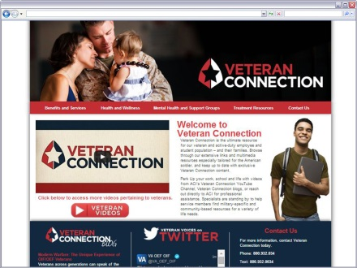

Specialized Veteran Services
ACI serves veteran and active duty
employee populations.
Veteran Connection website
Veteran clinicians
Veteran Connection Blog
Veteran videos on YouTube
Community-based resources
Military family support
Webinar trainings

Slide 9
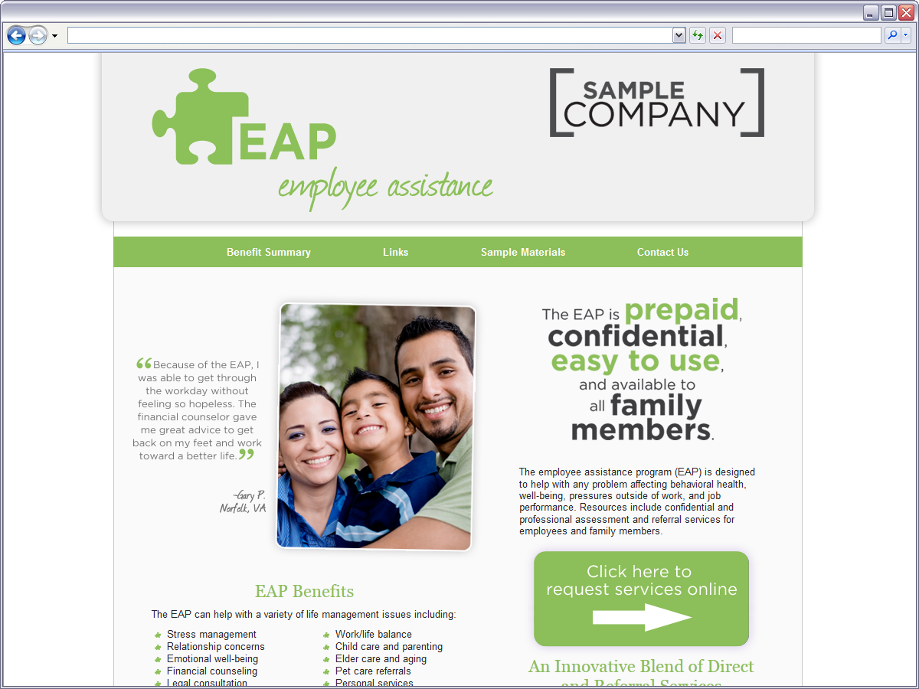
Online Access to EAP Benefits
Employee Landing Page:
Overview of benefits
Contact ACI or submit a request
Links to additional EAP resources
http://score.acieap.com/
Notes:
***Use if client only has landing page***

Slide 10

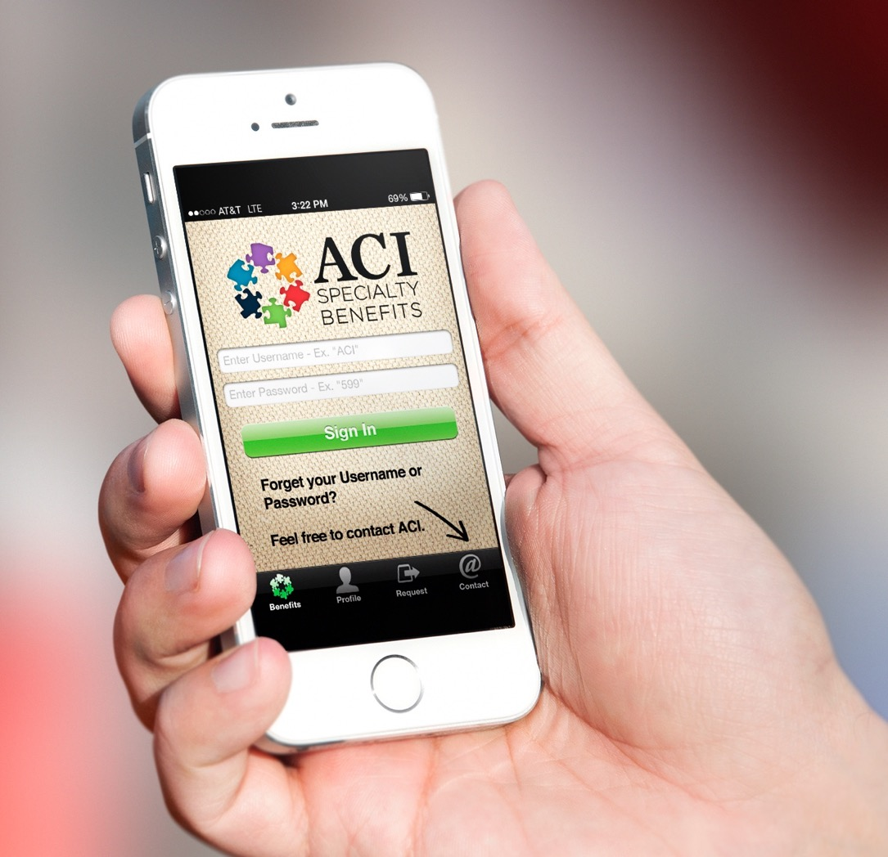


Mobile App Access to EAP Benefits
Instantly access EAP benefits with the
myACI mobile app on iOS and Android.
Sign in using the company code below,
complete a profile and submit a request.
Username: SCOR Password: 492
Username: SCOR492

Slide 11

Unlimited HR Support Services
ACI partners with clients to support HR goals, including retention, engagement and performance.
Services include:
Critical incident response
Workplace violence prevention
Supervisory referrals
Consultation for difficult employee issues and workforce transitions
Substance abuse case management and drug-free workplace act compliance
Consultation for compliance, safety, and risk management

Slide 12

Orientations and Training
ACI offers comprehensive training services to support HR goals through professional development:
Flexible training formats: In-person, online, YouTube
Quarterly management training series
Average 4.6/5 training rating
Library of training topics for any organizational need

Slide 13

Critical Incident Response
ACI is proud to be in a position to help clients in times of need:
Unlimited consultation with ACI’s crisis response team
Immediate social media outreach
Multimedia crisis support materials
Resources to build resilience to catastrophe
Consultation for risk management and safety
Onsite critical incident stress debriefing services available

Slide 14
How the CIR Process Works
Seamless Coordination of Care
Incident
Occurs
Call EAP
Number
Transfer to
CIR Team
Consult
Begins
Traumatic event such as employee death, robbery, workplace accident or violence occurs.
Always call the toll free number first: 800.932.0034.
Emails should be sent to cisd@acispecialty
benefits.com.
Do not rely on calling or emailing an individual contact.
An EAP specialist will ensure your call is transferred to a member of the crisis support service team no matter what time of day.
A crisis support team member will begin the consultation process by gathering information regarding the incident.

Slide 15

Supervisory Referrals
The EAP is not a part of the disciplinary process
ACI’s Supervisory Referrals are 100% confidential unless employee signs a
release of information
The SVR is an excellent problem-solving resource
Notes:
Earlier we talked about self-referrals where an employee or family member contact the EAP directly; however, ACI also offers a supervisory referral. A supervisory referral is when a manager recognizes that an employee’s job performance has deteriorated and that continuing or emerging patters of behavior are cause for concern.
A supervisor/manager’s role is:
To expect good job performance
To provide a safe work environment
To make sure the job gets done
To ensure quality in the product/service
To do this the manger must:
Know what it takes to get the job done
Know the employees’ abilities
Know is there is a change in either
Communicate job expectations
There may be times when additional support is needed in certain areas. This is where the supervisory referrals comes in.

Slide 16

Types of Job-Related Supervisory Referrals
Positive alcohol screen result
Frequent/unexplained absenteeism/tardiness
Absent from the worksite while on the job
Difficulty working with others
Inconsistency in quality/quantity
of work output
Extreme irritability/anger
Insubordination/questioning authority
Disregard for the safety of others
Notes:
Employees who display out-of-the-ordinary behaviors may be good candidates for the supervisory referral program. Some behaviors include:
Absenteeism
On-the-job absenteeism
Difficulty in concentration
Confusion
Inconsistent work patterns
Generally lowered job efficiency
Poor employee relationships
Mood swings or substance abuse
Overreactions to changes
Threats, even in jest
Blaming of others for serious problems
Repeated policy violations
Repeated references to weapons
Vague references to a “plan” to “get even”

Slide 17
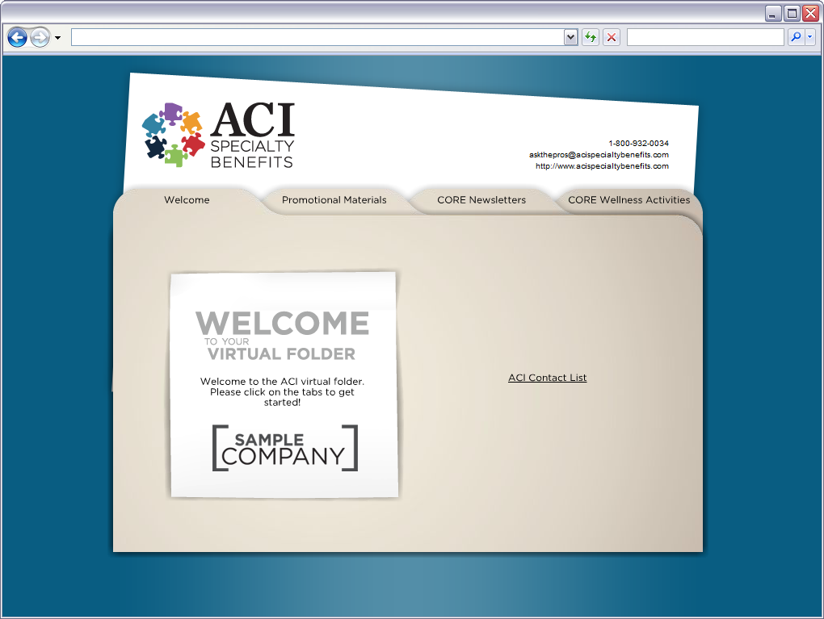

Manager/Supervisor/HR Virtual Folder
The virtual folder is your managers’ toolbox including:
ACI contact list
Promotional materials
Program training materials
Supervisory referral documents
http://vfolders.acieap.com/score/
Notes:
***Use if client only has landing page***

Slide 18
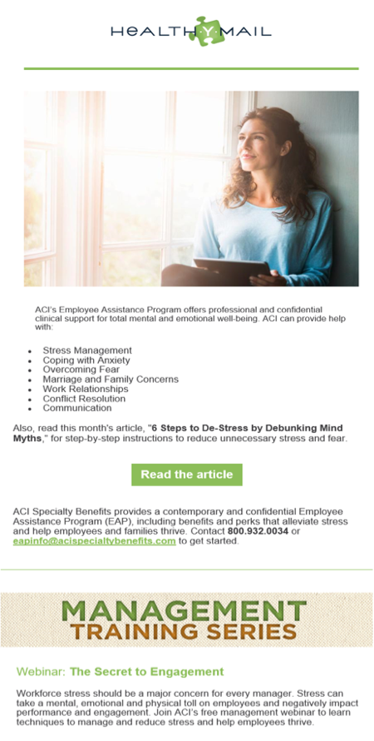
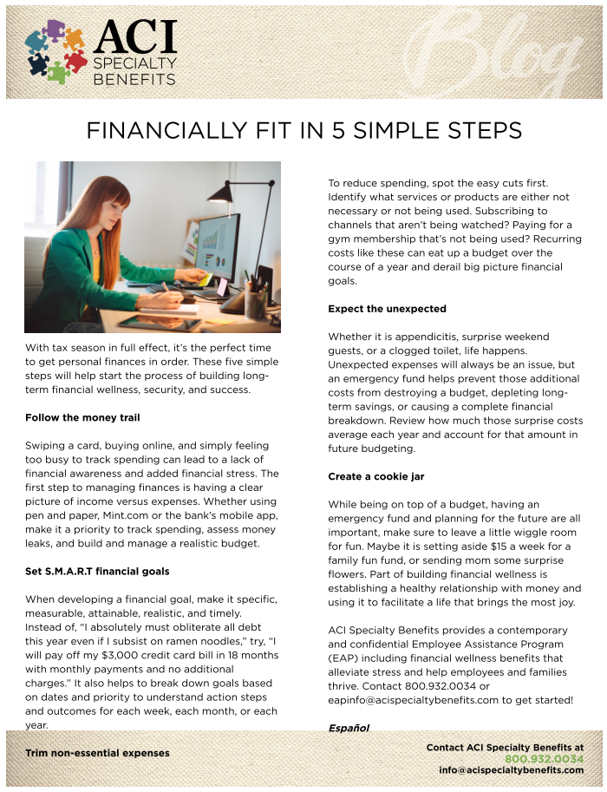
HealthYMail E-newsletter
Monthly e-newsletter covering timely topics on all areas of employee well-being
Includes invitation to Quarterly Management Training series
Intended to be distributed to your employees

Slide 19
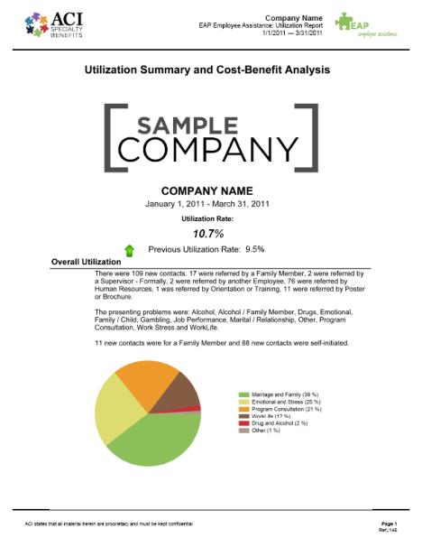
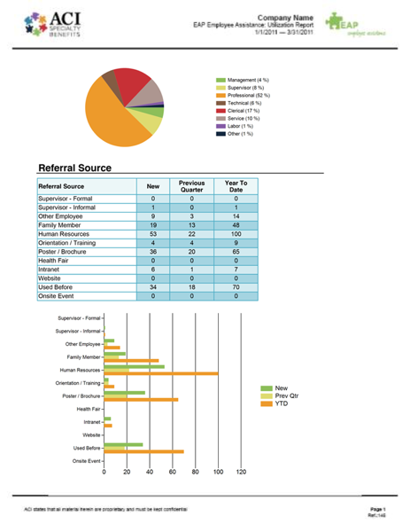
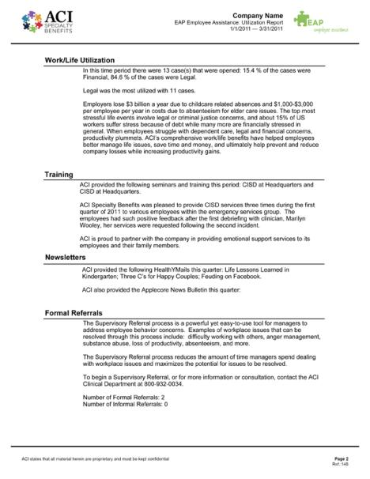
Confidential Utilization Reports
Quarterly utilization reports are provided via secure website
Features demographic data, usage trends and program engagement activities
All information provided by the employee and family member is protected by State and Federal Law
The utilization report has no identifying names or information included
Notes:
All information provided by the employee and family member is protected by State and Federal Law. No names will be on the utilization report. All information is confidential.

Slide 20






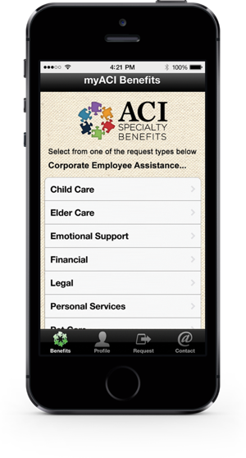





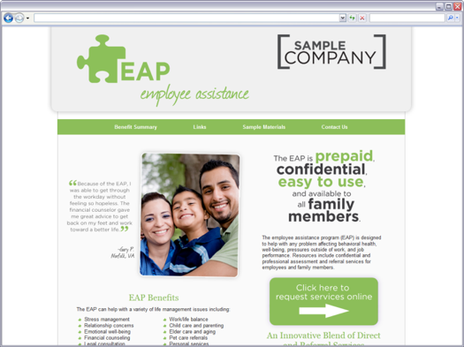




24/7 Program Access
Notes:
Phone, Web, Text, Email, Videos
myACI Mobile App
Social@ACI platforms
EAP landing page
Licensed mental health professionals are always available for after-hours calls.
On-call counselors are ready and waiting.
This is not an Emergency Number. Call 911 if there is an emergency.

Slide 21






ACI Partners with Great Places to Work
Meet HR Goals
Increase Benefits ROI
Enhance Company Culture
Support Workforce Well-Being
Maximize Performance Potential
Boost Employee Retention and Engagement
Notes:
In summary, EAP services:
Promotes early intervention for employees personal problems
Reduces employee absenteeism and low productivity
Facilitates good mental health which reduces overall health care costs
Communicates the company’s commitment to their employees’ well being
In turn:
Boost employee retention and engagement
Maximize performance potential
Support workforce well-being
Enhance company culture
Increases benefits ROI
Meet HR goals

Slide 22

Contact ACI Specialty Benefits
800.932.0034 info@acispecialtybenefits.com http://score.acieap.com/
Notes:
Please do not hesitate to contact us anytime by phone at 800.932.0034 or e-mail at info@acispecialtybenefits.com. Thank you for your time. ACI Specialty Benefits looks forward to serving your needs and the needs of your employees.

