Slide 1
Workers’ Compensation 101

Slide 2
Agenda
History of Workers’ Compensation
Reporting Injuries
Forms and Compliance
Benefits
Questions/Answers/Discussion

Slide 3
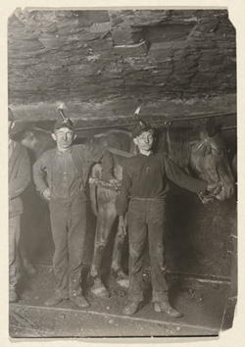
History of Workers’ Compensation
Previously known as: Workmans’ Comp
Before Workers’ Compensation
Employees Suing Employers
Civil Litigation was costly and adversely
affected the employer standing in business
1911 Workers’ Compensation Was Established
“No Fault” System – benefits cannot be denied due
to employee negligence
“Exclusive remedy” – employee can’t sue employer
Liberal laws and designed to provide benefits

Slide 4
Types of injuries
Specific Injuries
Struck by object, slip & fall, cuts, back strain while lifting, etc.
Cumulative Trauma
Condition caused by repetitive activities developing over time.
Aggravation Injuries
A pre-existing condition worsened by some aspect of employment--prior injury and medical records needed to determine apportionment.
Back, psyche, heart, etc.
Exacerbation is same injury. Aggravation is a new injury.

Slide 5
What is not work related
Off-duty activities
Injury caused by drugs/alcohol
Intentionally self-inflicted
Initial physical aggressor
Suicide
Injured during regular commute to/from work – coming and going rule
Commission of a felony or misdemeanor in/during an accident

Slide 6
What and when to report
Know what to report
Any injury or illness that is, or is alleged to be caused by employment or occurs while at work – industrial in nature
Know when to report
When you, your representative, or anyone else in authority hears from “any source” about an injury or occupational illness
L.C. 4600 and 5402 - Knowledge of an injury is imputed to the employer when information is obtained “from any source” – any management person in authority

Slide 7
Advantages
of prompt claim reporting
Speeds process of treatment, healing, and return to work
Allows HR and the York to more effectively investigate and evaluate claims
Reduces medical treatment costs
Reduces potential for injury aggravation
Decreases potential litigation and claim costs
Avoids penalties for delay of benefits

Slide 8
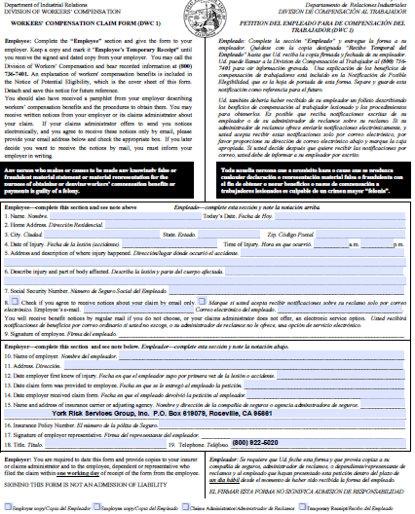
Reporting a claim
Workers’ Compensation Claim Form (DWC-1) Employee completes Nos. 1-9/Supervisor completes Nos. 10-19
MUST PROVIDE WITHIN 24 HOURS OF KNOWLEDGE

Slide 9
DWC-1 Form – key points
Give form to employee within 24 hours of knowledge
Give to employee anytime it is requested – do not deny the form!
Keep a log of DWC-1 forms given to employees and note when/if returned
Employee completes numbers 1-9 - Do not complete for them. Family member or spouse may complete if employee is unable.
Employer/Supervisor completes numbers 10-19
Provide a copy of the completed DWC-1 to employee
DWC-1 is not required for employee to complete or return. It will not be necessary if it is an incident only claim. Employees should complete the form any time medical treatment is sought to protect their right to benefits.

Slide 10
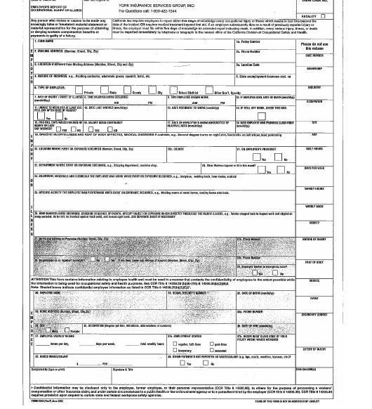
Form 5020
completed by HR

Slide 11
Incident and investigations
Gather facts and information at the onset of an injury --- witness statements
Do not delay investigating
Communicate all information to HR/York to assist with the investigation
Factual information is necessary – not a time for opinions and feelings
More information is better than not enough
Benefits:
Helps to determine the cause of accidents –trending and mitigation
Identifies unsafe/overlooked work practices and conditions
Increases opportunity to subrogate or recover costs from negligent third parties

Slide 12
Investigation of incidents
…continued
The supervisors report is very important for listing witnesses and supervisor names. Details matter.
If a case involves faulty equipment/external contribution, it is important to preserve the evidence.
If a contractor is involved, send a copy of the contract to York.

Slide 13
CAL-OSHA
reporting
In the event of a serious injury, notify Human Resources and/or Cal-OSHA as required by law. As soon as practically possible but not longer than 8 hours after the employer knows or with diligent inquiry would have known of the death or serious injury or illness
Definition of a serious injury:
An injury which causes death
Amputation of a body part
Serious disfigurement such as crushing or burn
In-patient hospital stay for 24 hours or more

Slide 14
What happens behind the scenes
…HR/York
York reviews all new loss information and sets up a claim file
Contacts are made. Any questions? Any discrepancies? Investigation?
Initial letters are sent out
Medical treatment is authorized- as appropriate
Once employee is discharged from care, and all payments are made, claim is closed (MO Claim)
If employee loses time from work, other benefits may be due
If employee suffers permanent disability, or needs continuing medical care, the issues need to be resolved by a settlement (C&R)
Additional medical evaluations may be needed

Slide 15
Employee benefits under workers’ compensation
Medical Treatment to cure or relieve from effects of injury. Mandatory application of Utilization Review. Delayed claims covered up to $10,000.
Temporary Disability (TD) and/or 4850 Benefits provided when unable to perform work.
Permanent Disability (PD) to compensate for inability to compete in the labor market.
Supplemental Job Displacement Benefit (SJDB).
Death benefits.
Note: A “claim” may be accepted, though there may be a denial on a specific benefit issue.

Slide 16
Medical treatment options
If it is a medical emergency, go to the nearest emergency or call 911.
For non-emergency medical care and follow-up treatment, the employee should use the designated Occupational Medical Clinic unless pre-designation form completed.
The injured employee should inform the medical provider who treats them that the injury is job related.
Nurse Case Managers may be assigned to facilitate treatment.

Slide 17
Medical treatment under workers’ compensation
Utilization Review Process
Medical treatment including pharmacy, durable medical equipment, and mileage
Chiropractic, physical & occupational therapy capped at 24 visits (unless post surgical)
All treatment in line with MTUS (Medical Treatment Utilization Schedule)
Pharmacy/medications

Slide 18
Labor Code Section 4850
Paid Leave of Absence
for Specified Public Employees
Whenever any person listed in subdivision (b) who is a member of PERS or a County Employees Retirement Laws is disabled, whether temporarily or permanently, injury or illness AOE/COE shall become entitled, regardless of his/her period of service with the City or County, to a leave of absence while so disabled without a loss of salary in lieu of TTD for the period of disability, but not to exceed one year or until that earlier date or is retired on PD Pension and is actually receiving disability pension payments or advance disability pension payments pursuant to Section 4850.3.
City Police Officers
City, County, or District Firefighters
Sheriffs
Officers or employees of any Sheriff’s office. In 1995 and 2000 this code section was amended to include County Probation Officers, Peace Officers, Designated Airport Law Enforcement Officers, Harbor or Port Police Officers, Wardens, and School District Police Officers. Reserve Police and Firefighters do not qualify for the special salary in lieu of compensation benefits.

Slide 19
Return to Work - Modified Duty
Modified duty refers to changing parts of the employee’s normal
duties to accommodate temporary physical limitations.
Employer Benefits
Eliminates costs of hiring new employees and temporary replacements.
No temporary disability payments.
May reduce permanent disability.
Medical savings (Employee recovers faster).
Improves employee morale.
Employee Benefits
Continues to be productive.
Remains in touch with co-workers and works in familiar setting.
Avoids feeling isolated and depressed.
Avoids financial stress.
Shows initiative and commitment to return to work.

Slide 20
Types of claim settlements
Stipulations: Settles out Permanent Disability and is paid out in a schedule.
Offers the injured worker lifetime future medical benefits for the affected body part.
Compromise & Release: Settles out permanent disability, future medical treatment, and the right to reopen the claim.
Paid out in a lump sum payment less any previous advance made during the claim.

Slide 21
Quiz – After Knowledge of an injury?
How long does an employer have to provide the employee with a DWC-1 Claim Form?
True or False: The employee should not be referred to the doctor until after WC Carrier (York) receives notice of the claim?

Slide 22
Quiz –
To Give or Not to Give?
Employee has food allergy and complains of a reaction because of something shared by co-worker during an office party. Employee leaves work and seeks medical treatment.
Give a DWC-1, or not?
Employee faints and hits head on the desk. Tells paramedics that she has diabetes and sometimes passes out from hypoglycemia.
Industrial or not?
Employee has a pre-existing back condition, but says back hurts after moving boxes and is going to the doctor.
Give a DWC-1, or not?

