Slide 1


Lessons Learned
October 2017
Cameron Dewey

Slide 2
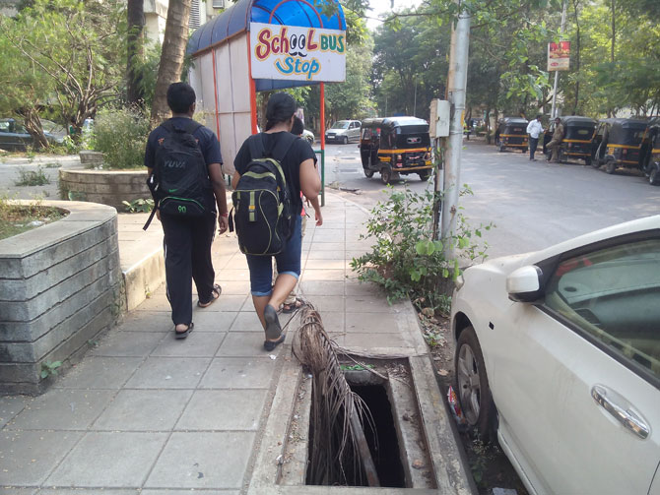
Lessons Learned 2017
So, you think your sidewalks are dangerous?

Slide 3
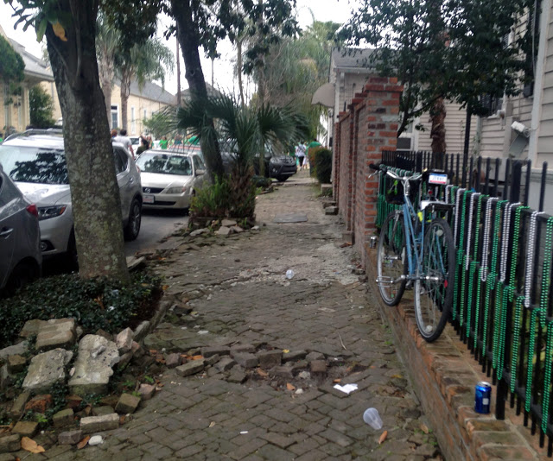
Lessons Learned 2017

Slide 4
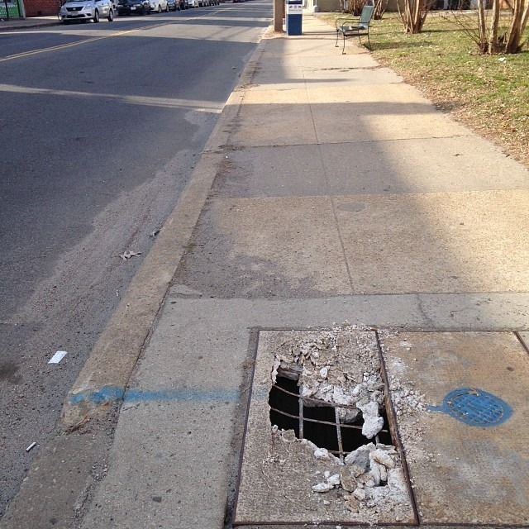
Lessons Learned 2017

Slide 5
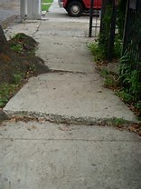
Lessons Learned 2017

Slide 6
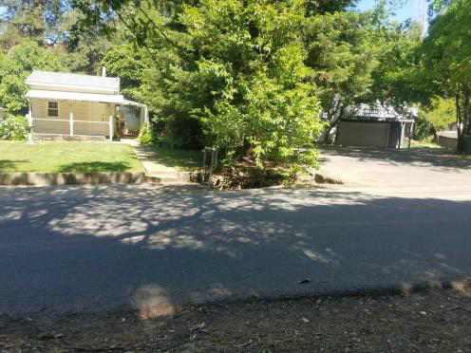
Lessons Learned 2017

Slide 7
Lessons Learned 2017

Slide 8
Lessons Learned 2017

Slide 9
Lessons Learned 2017
Dangerous Condition Theory
Government Code §835 provides the basis for liability in an action against a public entity for an injury caused by the dangerous condition of public property. To establish liability, the following essential elements must be proved:
Public Property Owned Or Controlled By Public Entity
  The property must be owned or controlled by a public entity. Govt. C. §830(c) defines “public property” and “property of a public entity” as “real or personal property” that is “owned or controlled” by the public entity.

Slide 10
Lessons Learned 2017
Govt. C. §830(a) defines “dangerous condition” as “a condition of property that creates a substantial (as distinguished from a minor, trivial or insignificant) risk of injury when such property or adjacent property is used with due care in a manner in which it is reasonably foreseeable that it will be used.”
“Condition of property” has been defined as a public improvement that has become physically changed, flawed or damaged, or has deteriorated to a degree that makes it potentially dangerous to reasonably foreseeable users, even when used with due care.
Examples:
  A sharp drop at the edge of a highway. Murrell v. State ex rel Dep’t of Pub. Works (1975)
  A boulevard stop sign that was obscured by foliage

Slide 11
Lessons Learned 2017
Finally, “condition of property” has been defined to include all public property that may be substantially dangerous to reasonably foreseeable users who sustain injury as a result of a combination of the following:
“condition of the property” (either physical defect or the absence of adequate safety features)
negligent or criminal conduct by others on or about the property

Slide 12
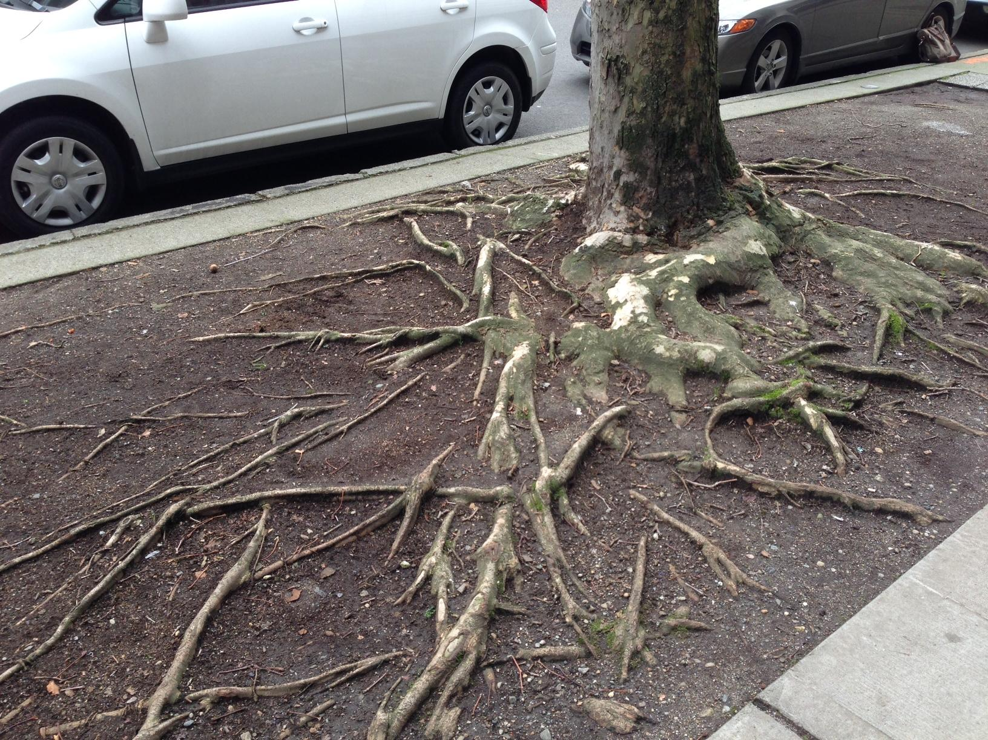
Lessons Learned 2017

Slide 13
Lessons Learned 2017
The majority of claims received for damage done by trees fall under two categories; Dangerous Condition Theory or Nuisance/Trespass Theory
Dangerous Condition Theory
  Example: tree branch falls and causes damages
  Defense: No prior actual or constructive notice of condition causing the failure (Gov. Code 835)
  City is immune from liability when the City’s act or omission was reasonable (Gov. Code 835.4)
  Defense: Gov. Codes 830.2 and 831.2 both apply to cases where a tree or tree limb has fallen and caused damage to a third party

Slide 14
Lessons Learned 2017
PROPERTY OWNER RIGHTS
Nuisance/Trespass Theory
  “Any unprivileged invasion of the property of another person, whether direct or indirect, constitutes a trespass.”
  Liability will generally result only if the trespass is intentional, negligent or extra-hazardous activity. Most tree claims will likely not meet the above test.
  The owner of the land in fee has the right to the surface and to everything apparently situated beneath or above it (Civil Code Section 829)
  The property owner must use his or her own property right so as not to infringe on the rights of another owner (Civil Code Section 3514)

Slide 15
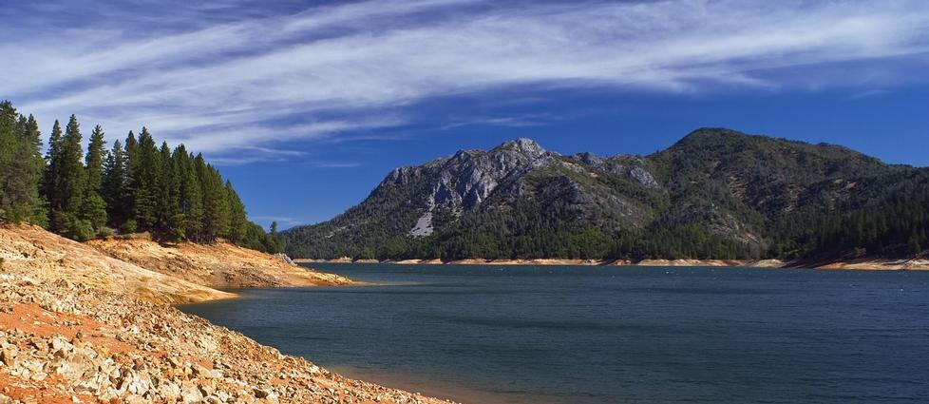
Lessons Learned 2017
NATURAL CONDITION
Neither a public entity nor a public employee is liable for an injury caused by a natural condition of any unimproved public property, including but not limited to any natural condition of any lake, stream, bay, river or beach. Gov. Code 831.2

Slide 16
Lessons Learned 2017
EXAMPLE
The Plaintiff alleges that on March 21, 2009 he was “on an improved portion” of Elkhorn Park – the parking lot, with his boat still on its trailer, when a dead tree fell and struck him; that many of the trees along the river at that location were leaning away from the river, toward and over the boat ramp parking lot, and were diseased and/or infected with mistletoe, rendering them dangerous.

Slide 17
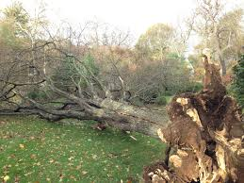
Lessons Learned 2017
The Plaintiff elaborated on their dangerous condition theory by asserting YOLO negligently performed its management of forestry and riparian habitat by not properly inspecting and maintaining/pruning the surrounding trees, as well as by failing to warn intended users of the premises of the potential danger from falling trees.

Slide 18
Lessons Learned 2017
Government Code section 835 creates liability to public entities for “an injury caused by a dangerous condition of its property” where that dangerous condition proximately
  caused the injury and
  that injury was a reasonably foreseeable risk of the condition, if the public entity (via its employee) either created the dangerous condition or had sufficient prior notice of the condition to prevent the harm

Slide 19
Lessons Learned 2017
EXCEPTIONS
Natural conditions of unimproved public property, including of any stream or river.
  “[n]either a public entity nor a public employee is liable for an injury caused by a natural condition of any unimproved public property, including but not limited to any natural condition of any lake, stream, bay, river or beach.” Gov. Code § 831.2
Natural condition immunity allows public recreational use of government lands and waterways which might otherwise be foreclosed by the high cost of rendering safe natural hazards and responding to corresponding tort actions.

Slide 20
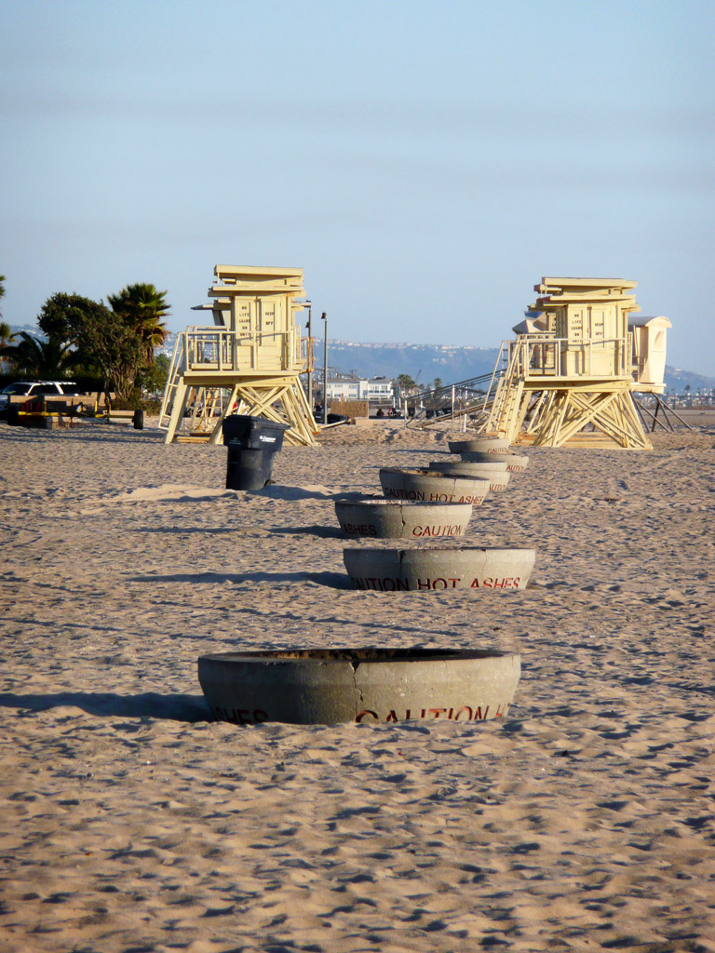
Lessons Learned 2017
Sacramento River’s tree-lined banks comprising Elkhorn Regional Park are unimproved public property, the natural status of which was not abrogated by the nearby presence of a boat launch, restrooms and parking lot.
Bartlett, supra, 199 Cal.App.3d at 398 – 399, minimal improvements such as signs, roads, toilets and trails do not render natural area improved for purpose of § 831.2.
Fuller, supra, 51 Cal.App.3d at 936 – 939 held that although the state beach had been “developed” by restrooms, campfire rings, lifeguard towers and signs, it did not render the beach improved for purpose of § 831.2 and the immunity applied.

Slide 21
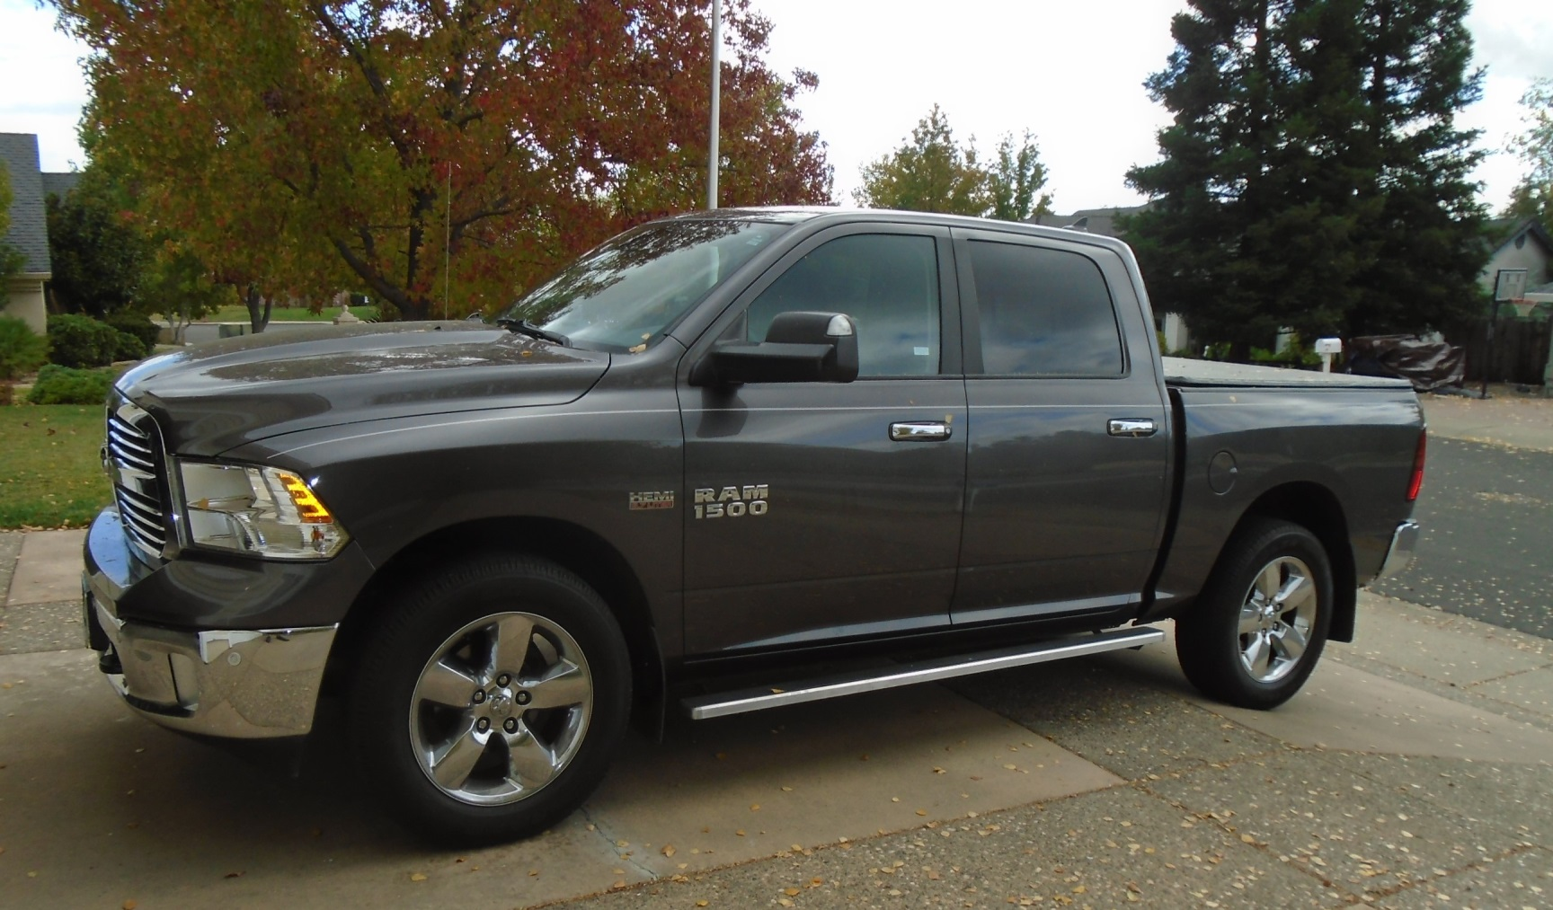
Lessons Learned 2017
Any Questions?

