Slide 1
STATE OF THE INSURANCE MARKET 2017
(THIS INFORATION HAS BEEN CONSOLIDATED FROM VARIOUS INDUSTRY SOURCES)
Small Cities Organized Risk Effort
10/13/2016 Presented by: Marcus Beverly Alliant Insurance Services

Slide 2
Presentation Overview
Highlights
Property/Casualty Industry Performance
Impact of Natural Catastrophes
Data Breaches Continue to Soar
Evolving Risks
Flood, Police Actions, Drones, Self-Driving Cars, and Business Interruption
Looking Ahead…
2

Slide 3
Highlights
For the first half of 2016, Global catastrophic (CAT) losses are at their highest level since 2011; global economic losses reached $98 billion, with global insured losses at $30 billion, still slightly below their 10-year averages of $112 billion and $31 billion respectively. However, the losses were slightly above the longer-term averages of $84 billion and $24 billion dating back to 2000.
The P&C Combined Ratio has deteriorated to 100% as of 9/14/16 per A.M. Best
Policyholder surplus is $676.3B as of 03/31/16.
The WC Combined Ratio for 2015 is projected at 94%. Workers’ comp results began to improve in 2012. Underwriting results deteriorated markedly from 2007-2011 and were the worst they had been in a decade.
Due to persistently low interest rates, investment income fell in 2012, 2013 and 2014 but showed a small (1.9%) increase in 2015—another drop in 2016 seems likely.
Weather extremes (Tropical Storm Hermine, Flooding in Louisiana & Texas), catastrophic losses and investment earnings are areas of concern for carriers.
3

Slide 4
Commercial Insurance Prices Nearly Flat in the First Quarter
Commercial insurance prices were down slightly during the first quarter of 2016, according to Towers Watson's most recent Commercial Lines Insurance Pricing Survey (CLIPS) data.
Consistent with Q4 2015, three lines of coverage reported modest price decreases:
Workers Compensation,
Commercial Property,
and Directors and Officers
The outlier in the results continues to be commercial auto, where price increases continue to be reported and have even mildly accelerated over the past three quarters. Price changes for most other lines fell in the low single digits.
Source: Towers Watson Commercial Lines Insurance Pricing Survey
4

Slide 5
Change in Commercial Rate Renewals, by Line: 2016:Q1
Percentage Change (%)
Commercial Auto rate increases are larger than any other line, followed by EPL and D&O
Major Commercial Lines Renewals Were Mixed to Down in Q1:2016;
EPL, D&O and Commercial Auto Saw Gains
Note: CIAB data cited here are based on a survey. Rate changes earned by individual insurers can and do vary, potentially substantially
Source: Council of Insurance Agents and Brokers; Insurance Information Institute
.
5

Slide 6
P/C Industry Net Income After Taxes 1991–2016:Q1 (Est.) (Millions)
2005 ROE*= 9.6%  2011 ROAS1 = 3.5%
2006 ROE = 12.7%  2012 ROAS1 = 5.9%
2007 ROE = 10.9%  2013 ROAS1 = 10.2%
2008 ROE = 0.1%  2014 ROAS1 = 8.4%
2009 ROE = 5.0%  2015 ROAS = 8.4%
2010 ROE = 6.6%  2016:Q1 ROAS = 7.9%
Net income in Q1:2016 on an annualized basis was on track to match full-year 2015
$ Millions
ROE figures are GAAP; 1Return on avg. surplus. 2016 data are for Q1. Excluding Mortgage & Financial Guaranty insurers yields a 8.2% ROAS in 2014, 9.8% ROAS in 2013, 6.2% ROAS in 2012, 4.7% ROAS for 2011, 7.6% for 2010 and 7.4% for 2009; 2015E is annualized figure based actual figure through Q3 of $44.0
Sources: A.M. Best, ISO; Insurance Information Institute
6

Slide 7
Property/Casualty Insurance Industry Investment Income: 2000–2016:Q1
($ Billions)
Investment earnings are still below their 2007 pre-crisis peak
Due to persistently low interest rates, investment income fell in 2012, 2013 and 2014 but showed a small (1.9%) increase in 2015—another drop in 2016 seems likely
1 Investment gains consist primarily of interest and stock dividends. *2014 figure is estimated based on annualized data through Q3.
Sources: ISO; Insurance Information Institute
7

Slide 8
Policyholder Surplus, 2006:Q4 – 2016:Q1
($ Billions)
2007:Q3 Pre-Crisis Peak
Drop due to near-record 2011 CAT losses
Surplus as of 3/31/16 stood at a record high of $676.3B
The industry now has $1 of surplus for every $0.77 of NPW, close to the strongest claims-paying status in its history.
2010:Q1 data includes $22.5B of paid-in capital from a holding company parent for one insurer’s investment in a non-insurance business.
The P/C insurance industry entered 2016 in very strong financial condition.
Sources: ISO, A.M .Best.
8

Slide 9
Net Premium Growth (All P/C Lines): Annual Change, 1971 — 2015:Q3P
(Percent)
1975-78
1984-87
2000-03
Net Written Premiums Fell 0.7% in 2007 (First Decline Since 1943) by 2.0% in 2008, and 4.2% in 2009, the First 3-Year Decline Since 1930-33.
Outlook
2016F: 4.0%
2017F: 3.8%
2015:Q3: 3.1%
2014: 4.1%
2013: 4.4%
2012: +4.2%
Shaded areas denote “hard market” periods
Sources: A.M. Best (1971-2013), ISO (2014-15).
9

Slide 10
U.S. Insured Catastrophe Losses
2012 was the 3rd most expensive year ever for insured CAT losses
$11.0B in insured CAT losses through 6/30/16
($ Billions, $ 2015)
2013/14/15 were welcome respites from 2011/12, among the costliest years for insured disaster losses in us history. 2016 is off to a costlier start.
*Through 6/30/16. 2016 figure stated in 2016 dollars.
Note: 2001 figure includes $20.3B for 9/11 losses reported through 12/31/01 ($25.9B 2011 dollars). Includes only business and personal property claims, business interruption and auto claims. Non-prop/BI losses = $12.2B ($15.6B in 2011 dollars.)
Sources: Property Claims Service/ISO; Insurance Information Institute
10

Slide 11
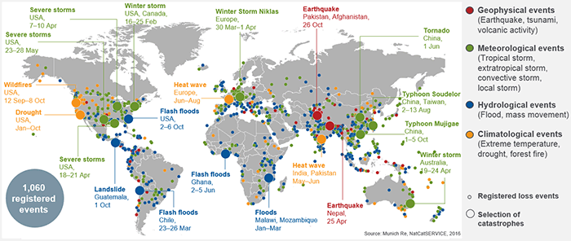
Loss Events Worldwide 2015
Global insured CAT losses totaled $27 billion in 2015, 21% below the $31 billion average over the past 30 years (1985-2014, adj. for inflation)
Source: © 2016 Munich Re, Geo Risks Research, NatCatSERVICE. As of March 2016.
11

Slide 12
First Half 2016 Cat Losses by Type - Severe Thunderstorms Lead the Way
As of July 12, 2016 | Number of Events | Fatalities | Estimated Overall Losses (US $million) | Estimated Insured Losses (US $million)*
Severe Thunderstorm | 21 | 25 | 11,600 | 8,500
Winter Storms & Cold Waves | 8 | 55 | 2,300 | 1,500
Flood, Flash Flood | 60 | 3,300 | 3,300 | 1,000
Earthquake & Geophysical | - | - | - | -
Tropical Cyclone | - | - | - | -
Wildfire, Heat Waves & Drought (ongoing drought conditions without loss estimation for half the year) | 5 | 10 | 200 | Minor Losses
Totals | 94 | 3,390 | 17,400 | 11,000
12

Slide 13
Top 16 Most Costly Disasters in U.S. History—Katrina Still Ranks #1
(Insured Losses, 2014 Dollars, $ Billions)
Storm Sandy in 2012 was the last mega-CAT to hit the US
Includes Tuscaloosa, AL, tornado
Includes Joplin, MO, tornado
12 of the 16 Most Expensive Events in US History Have Occurred Since 2004
Sources: PCS; Insurance Information Institute inflation adjustments to 2014 dollars using the CPI.
13

Slide 14
P/C Insurance Industry Combined Ratio 2001–2016:Q1 (Est.)*
As recently as 2001, insurers paid out nearly $1.16 for every $1 in earned premiums
Higher CAT losses, shrinking reserve releases, toll of soft market
Relatively low CAT losses, reserve releases
Relatively low CAT losses, reserve releases
3 consecutive years of U/W profits: first time since 1971-73
Heavy use of reinsurance lowered net losses
Average CAT losses, more reserve releases
Elevated CATs
Sandy impacts
Best combined ratio since 1949 (87.6)
Cyclical deterioration
Lower CAT losses
* Excludes Mortgage & Financial Guaranty insurers 2008--2014. Including M&FG, 2008=105.1, 2009=100.7, 2010=102.4, 2011=108.1; 2012:=103.2; 2013: = 96.1; 2014: = 97.0.
Sources: 2016 figure from ISO/Verisk; A.M. Best, ISO (2014-2015); Figure for 2010-2013 is from A.M. Best P&C Review and Preview, Feb. 16, 2016.
14

Slide 15
Workers Compensation Combined Ratio: 1994 – 2015P
WC results have improved markedly since 2011
Workers’ comp results began to improve in 2012. Underwriting results deteriorated markedly from 2007-2010/11 and were the worst they had been in a decade.
Sources: A.M. Best (1994-2009); NCCI (2010-2015P) and are for private carriers only; Insurance Information Institute.
15

Slide 16
Data Breaches 2005-2015, by Number of Breaches and Records Exposed
# Data Breaches/Millions of Records Exposed
Millions
The total number of data breaches (+27.5%) hit a record high of 783 in 2014, exposing 85.6 million records. Through June 30, this year has seen 117.6 million records exposed in 400 breaches.*
Source: Identity Theft Resource Center,
http://www.idtheftcenter.org/images/breach/ITRCBreachReport2015.pdf
*2007-2012 figures exclude mortgage and financial guaranty segments.
16

Slide 17
Estimated Cyber Insurance Premiums Written, 2014 – 2020F
Cyber insurance premiums written could more than triple to $7 billion by 2020
$ Billions
Source: Advisen (2014 est.); PWC (2015, 2020); Insurance Information Institute.
17

Slide 18
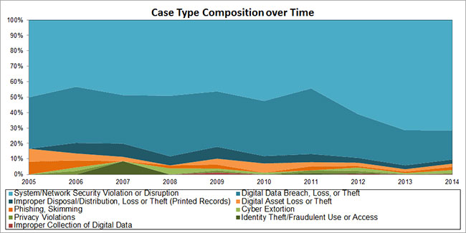
Cyber business interruption cases increase 52%
Of all the cyber-related business interruption cases tracked by Advisen’s Loss Insight database, system/network security violation or disruptions” (in light blue) clearly constitutes the largest percentage. This is followed by “digital data breach, loss or theft.” The smaller slivers deserve some attention, as a case-type category such as cyber extortion is on the rise as is phishing.
18

Slide 19
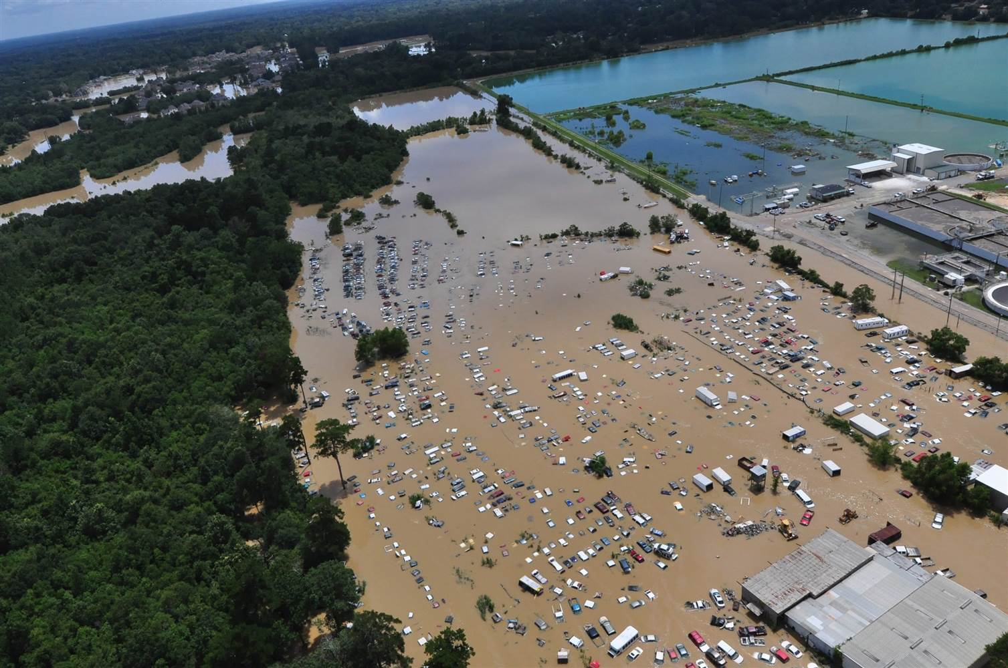
Flood Risks . . . .
Louisiana, August 2016
19

Slide 20
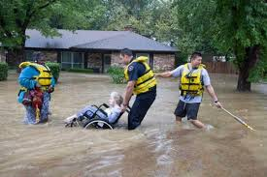
. . . . Continue To Expect the Unexpected
Lubbock, TX, August 2016
20

Slide 21
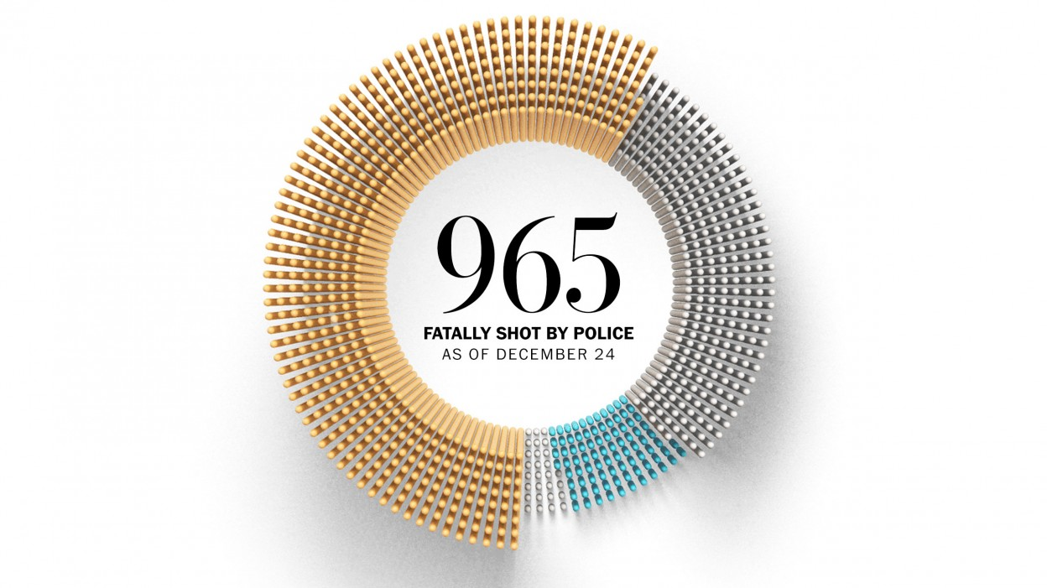
Officer-Involved Police Shootings
Per The Washington Post, nearly 1,000 people were shot dead by police in the nation in 2015…….
21

Slide 22
Police Officer Actions & Use of Force . . . .
Broadly speaking, the use of force by law enforcement officers becomes necessary, and is permitted under specific circumstances, such as in self-defense or in defense of another individual or group.
There is no single, universally agreed-upon definition of use of force. The International Association of Chiefs of Police has described use of force as the "amount of effort required by police to compel compliance by an unwilling subject" [1]
Officers receive guidance from their individual agencies, but there is no universal set of rules that governs when officers should use force and how much.
Officer training with fire arms is less one would anticipate, and overall Officer training is likely one key answer to mitigate problems.
[1] International Association of the Chiefs of Police, Police Use of Force in America, 2001 (pdf, 88 pages), Alexandria, Virginia, 2001. [exit notice].
22

Slide 23
. . . . And They Continue
714
People shot and killed by police as of
September 2016…….
on track to surpass last year.
23

Slide 24
Use of Force Actions - - Context Counts
No two situations are the same, nor are any two officers. In a potentially threatening situation, officers quickly tailor their response and apply force, as necessary.
Situational awareness is essential; officers are trained to judge when a crisis requires the use of force to regain control of a situation. Time becomes the key variable in determining when an officer chooses to use force.
24

Slide 25
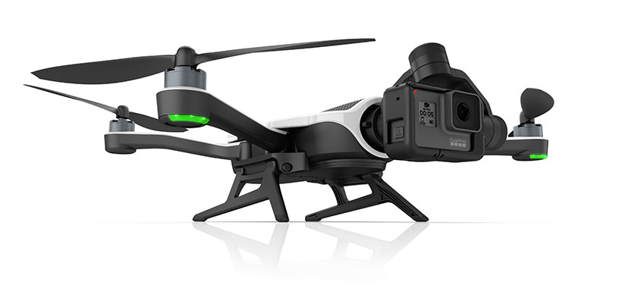
It’s a Bird, It’s a Plane . . . .
GoPro has just released its Karma Camera Drone.
It automatically follows you and captures your adventure from above.
25

Slide 26
. . . . Drone, Drone and more Drones
An unmanned aircraft system (UAS) or drone, is an aircraft without a human pilot onboard – instead, the UAS is controlled from an operator on the ground. (Definition from Federal Aviation Administration)
The FAA’s recently announced rules for commercial operation of small Unmanned Aircraft Systems (UAS or drones), set to take effect later this year, provide long-awaited guidance to drone operators and manufacturers and open the floodgates of opportunity to many businesses that hope to utilize drone technology in various ways in coming years.
26

Slide 27
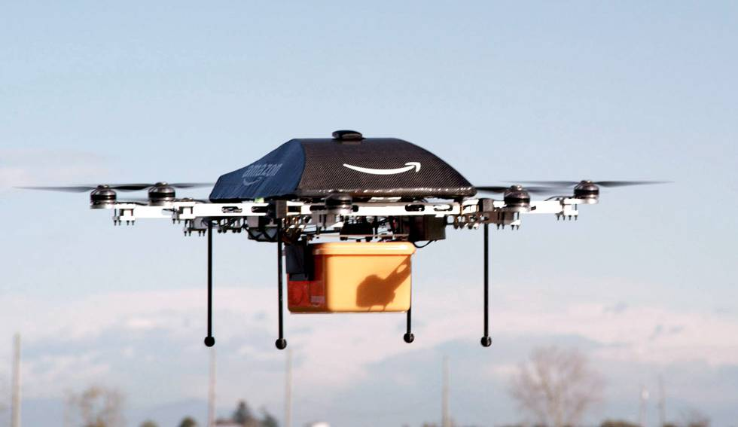
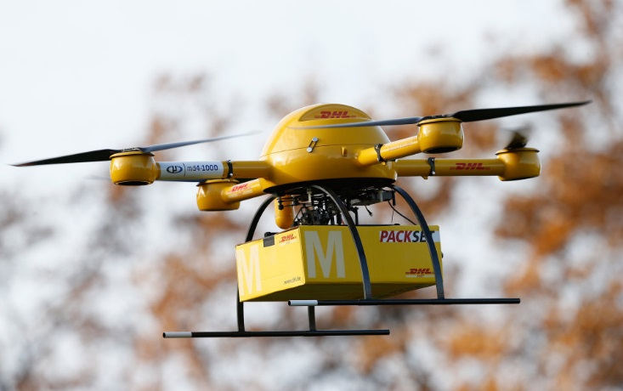
Commercial Use of Drones
Numerous companies are currently developing businesses focused around the transportation or delivery of products or objects by drones.
Google’s Alphabet has teamed up with Chipotle, and is currently testing delivery of burritos on a college campus.
27

Slide 28
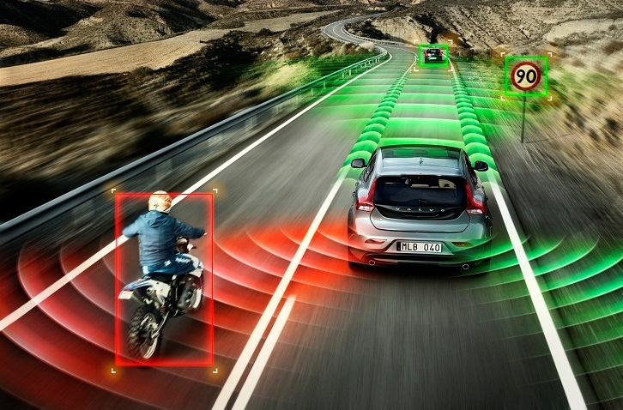
Autonomous Vehicles are coming soon!
Ford Motor Company Executive Chairman William Ford puts it this way: “In the next few years smart cars will be doing things you can hardly imagine today.”
Accordingly, Ford is “changing the way the world moves. We are rapidly becoming both an auto company and a mobility company . . . . The mobility revolution is here.”
30

Slide 29
Benefits & Drawbacks of Self-Driving Cars
Benefits
Nearly No Error
Eases Congestion
Eases Parking Woes
Potential for New Design
Potential for More Powerful Vehicles
Drawbacks
Expensive
Potential for Technology To Go Wrong
Licensing Infrastructure Not Yet In Place
Potential for Greater Pollution
Potential Loss of Privacy
Source: Unbelievable Benefits And Drawbacks Of The Self-Driving Car
LifeHack TECHNOLOGYBY ALICIA PRINCE
31

Slide 30
Business Interruption
What is BI?
Business Interruption provides coverage for loss of business, services or rental income resulting directly from the physical damage of an insured property. Includes tax revenue interruption and tuition income.
Why it is important to you
Public Entities looking for ways to generate revenue
Recycled Water Sales
Solar Energy
Recreational Activities – sports parks & camps
Habitation (Tenancy) Risks
32

Slide 31
Looking Ahead . . . .
Expectations are that rates will remain flat to slightly down into 2017 - barring an increase in claims severity and/or any industry changing events (i.e. hurricane, new legislation, court decisions, insurer insolvency).
Some lines of coverage will see modest decreases, while others such as law enforcement liability, flood, commercial automobile liability and employment practices liability (EPL) may see price increases.
33

Slide 32
STATE OF THE INSURANCE MARKET 2017
Thank You
Please contact us if you would like a copy of this presentation.
Marcus Beverly
Marcus.Beverly@Alliant.com
916-643-2704
(THIS INFORATION HAS BEEN CONSOLIDATED FROM VARIOUS INDUSTRY SOURCES)
Questions?

